Slide 1
OS 2 – Project 2
Word Statistic (Files analyser)

Slide 2
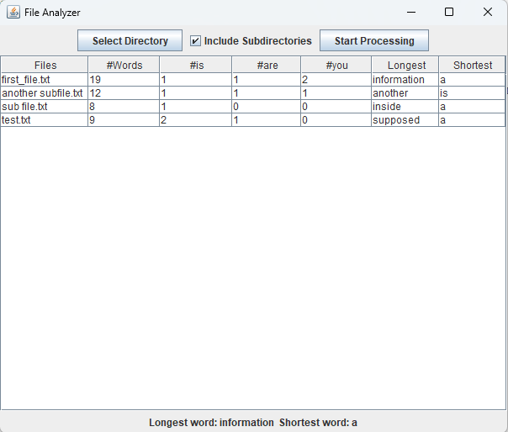
File analyser (Word statistic) Application
Lists out all files (Includes subdirs if needed).
Analyses each file in the chosen directory.
Gets the longest, shortest words among all files.
Output is in real-time.

Slide 3
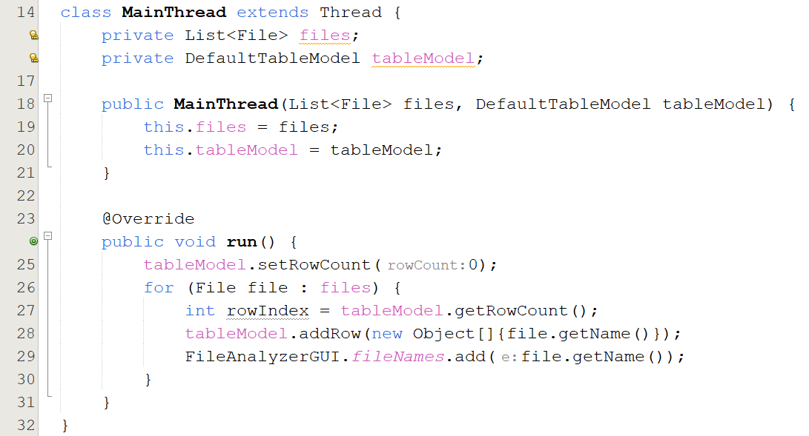
MainThread Thread
Extends Thread for concurrent processing
run(): Sets up the table model with file names

Slide 4
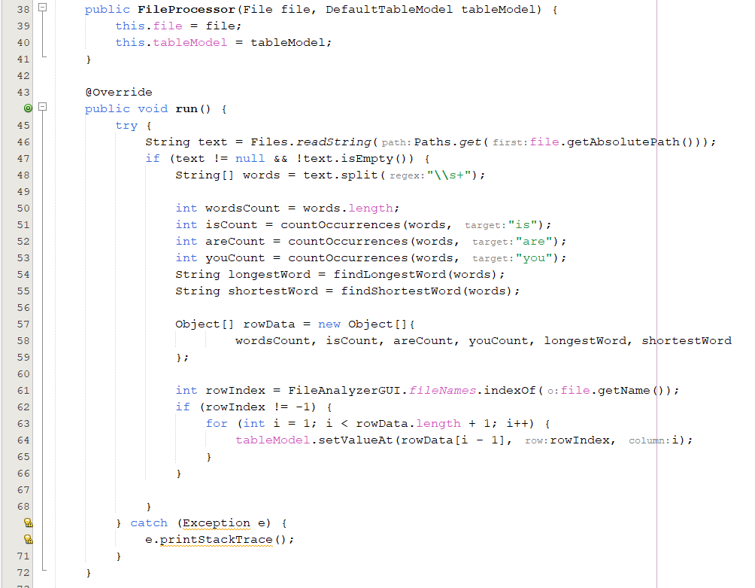
FileProcessor Thread
Extends Thread for processing individual files
run() : Processes files, counts words, finds longest/shortest words, then addes it to the table rows

Slide 5
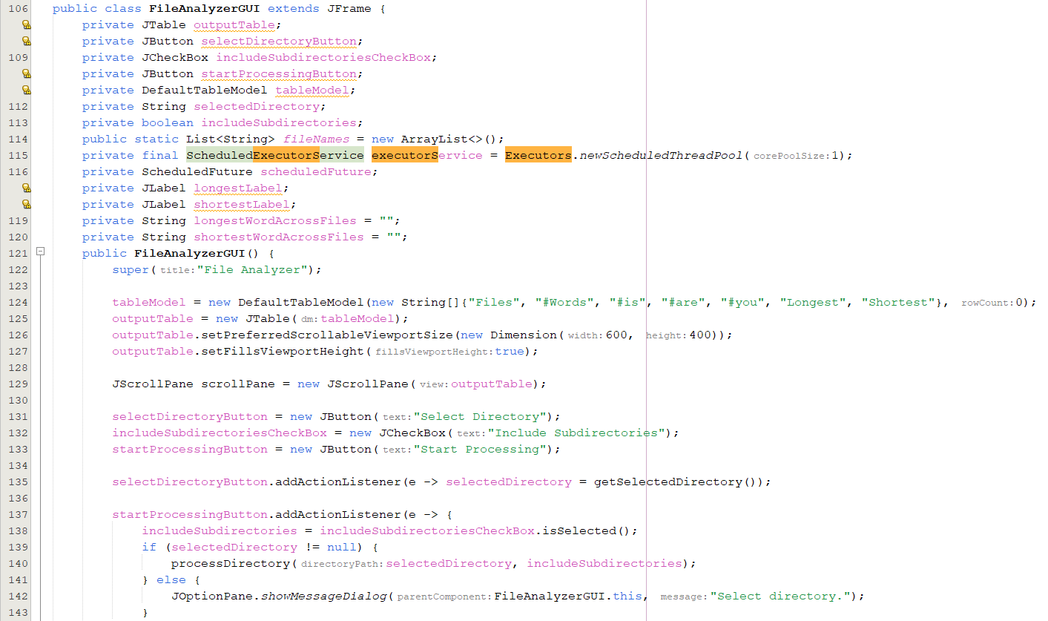
File Analyser GUI
This is a snippet from the main GUI class for the application.
Sets up buttons, checkbox, Jtable, Selected directory Path, etc…
Once startProcessing button is pressed, processDirectory() occurs.

Slide 6
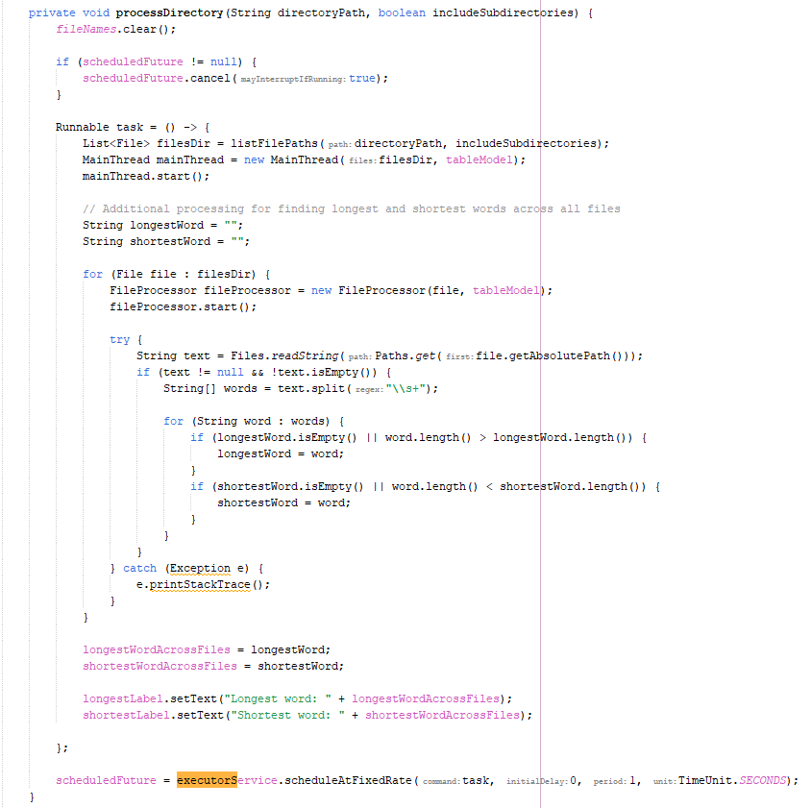
processDirectory()
This function takes the directoryPath as param, and a Boolean value includeSubdirs.
Makes sure the fileNames list is clear.
Cancels the previous scheduledFuture to prevent it from running two directories on the same time (In case user chooses another directory then it will clear the previous directory)
Creates a runnable that runs the MainThread along a FileProcessor thread for each file.
Calculates the longest and shortest among all files and adds them to the GUI labels.-
Runs an executorService to repeat the runnable process every 1 second (To capture updates in real-time).

Slide 7
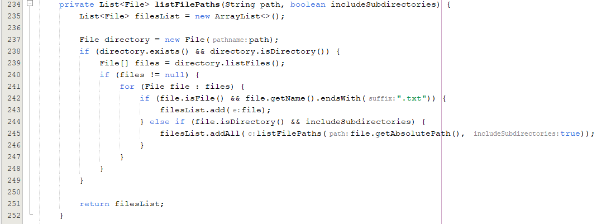
listFilePath()
Takes the directory path and if it includes subdirectories as params.
Lists out all txt files into that directory.
Returns the files paths as a list of files.

